Slide 1
Soar Analysis
Student Name
Course
Date
Faculty Name

Slide 2
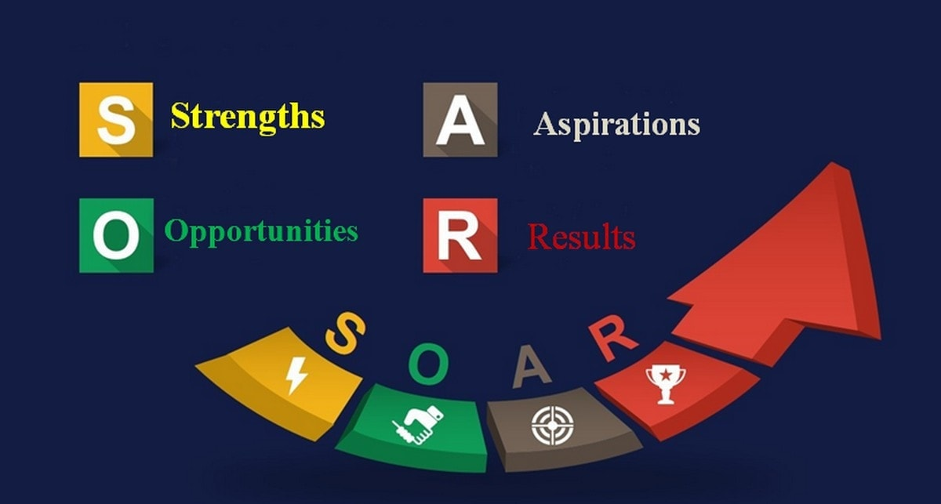
Strengths
Strengths include things that distinguish one person from another and easy to achieve. Diversity portrays the characteristics and traits that make people unique. My diversity strengths include;
Education.
Ethical values determine my interaction with people.
I highly regard cultural diversity aspect in workplace.
I consider inclusion in terms of free expression of behaviors and norms.
Notes:
According to the SOAR analysis, it considers four-element strengths, Opportunities, Aspirations, and Results to assess internal and external factors (Cole et al., 2019). In the case of personal diversity analysis using SOAR, Strengths are the traits that distinguish a person from the result in the view of diversity and inclusions. Strengths are those traits that can be built on to give a better result. Personal opinions on inclusion can significantly impact the effect and appreciation of the differences. Individual strengths include education that has enabled me to appreciate peoples' differences and equally understand how they affect organizations and institutions' behavior. Further, I based my actions and interaction on the value of ethics. The focus of cultural diversity helps me understand different cultures and how society affects the behavior of others. Also, I know inclusion as an appreciation that people show towards each other in the free expression of ideas, actions, and norms.

Slide 3
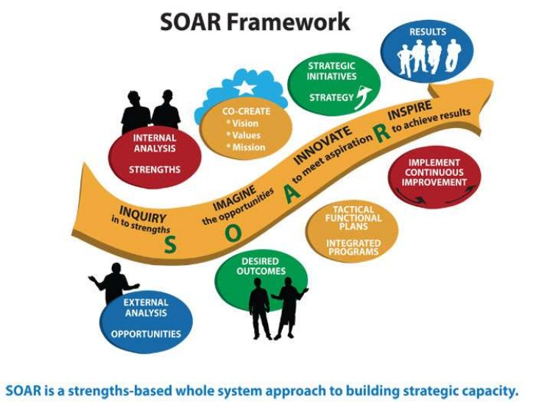
Opportunities
Opportunities are chances and possibilities that a person has to build on strengths.
When the opportunities are exploited they improve results. Other ways that I explore personal diversity;
How I approach problems
Abilities
Leadership
Notes:
Opportunities present chances that, when exploited, they become resourceful (Zarestky & Cole, 2017). The three significant ways that I explore my diversity include how I approach problems. People are different in cognitive ability to solve problems. I am a quick thinker and adequately analyzing the consequences of every action taken. That is resourceful, and it means that I can understand and work with a diverse team. Also, ability includes playing soccer, which has enabled me to appreciate teamwork. Also, the leadership roles that I have in my soccer team greatly impact the way people view differently and provide a chance to acquire more knowledge about myself and the whole team.
Image Source: https://www.slideshare.net/slidemodel/slidemodel-soar-model-powerpoint-template

Slide 4
Opportunities continuation
Further, my family background has influenced my behavior, beliefs, and actions.
I was brought up in a Christian family and taught me the values of the religion, which I draw my guidance.
So, I would like to understand more about Christian values, beliefs, and practices.
Also, the ethnicity of my family would extensively offer possibilities of personal development and appreciating my uniqueness.
The major challenge is understanding people's differences and appreciating them.
Through self-awareness and acceptance, people’s differences can turn out to be an opportunity for improving knowledge about different cultures, religions, races, gender, and more.
Notes:
Exploring family background and heritage is the beginning of self-awareness (White et al., 2018). The way people are brought up is different, and they get values and beliefs from families. So, through the understanding of ethnic history and religious socialization, it will increase self-awareness, acceptance, and knowledge of other people with diverse backgrounds. Even when I play with my soccer team, the major challenge with diversity appreciates different beliefs, practices, and norms. Despite being a challenge, that can be an opportunity presented to improve my knowledge about diversity and inclusion and allow everybody to feel free to express themselves differently.

Slide 5

Aspirations
The two aspects of my cultural identity that I would like to change is social class and gender equality.
My cultural identity is regarded as a low or average social class, and I would like to improve it.
Due to beliefs and norms, women have not entirely given equal chances to both genders in the economic sector as men.
Further, the public's people of my culture are generalized by the public to be aggressive, but I wish people were treated as individuals rather than a group.
Notes:
Aspirations are the aims that an organization wants to achieve (Cole et al., 2019). In this case, the few things that I would like to achieve are improving my cultural community's social status. Though there few people rich identified with my culture, I would want to improve my social status. Many people believe the fact that were are aggressive, but I wish they knew us better. Aggression could be caused by mental illness or frustrations, but we are hardworking and contribute hugely to the economic development.
Image Source: https://smackslide.com/slide/slide-1-x4qywf

Slide 6
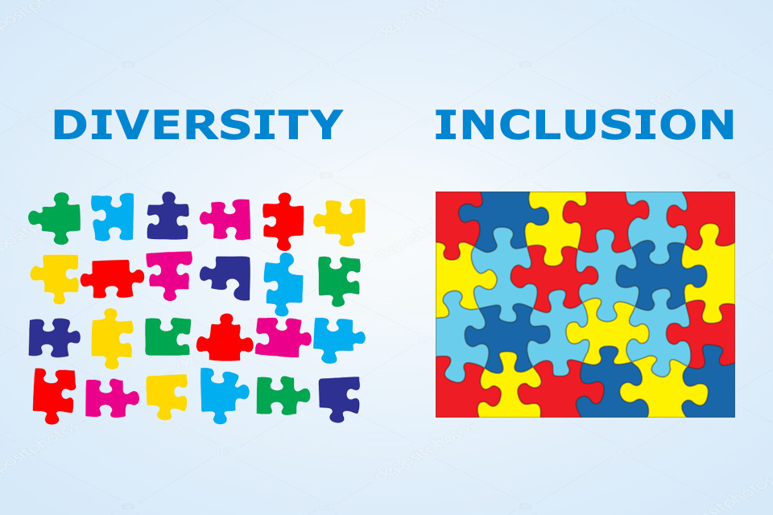
Results
Increased understanding of diversity and inclusion increases appreciating one another.
Equally, a better understanding of the same can significantly change;
Personality
Cognitive style
Knowledge and experiences
Also, in the workplace, when employees learn and understand how diversity and inclusion work, it fosters diverse thinking.
Other aspects that would improve;
Talents, experiences, and skills in the workplace
Creativity and innovation
Notes:
Results measure the goals and aspirations that have been achieved (Zarestky & Cole, 2017). On a personal level, increasing my understanding of inclusion and diversity is likely to change my personality, reason with people, and improve my knowledge and experiences. As a result, I will be more tolerant of diverse opinions and views when having conversations. Also, it will open a door for learning, which contributes to understanding each other with organizations. When the same is taught in an organization, people allow diverse thinking that improves talents, skills, and experiences since people are appreciated for who they are. Also, people's diversity and uniqueness within the organization are directly related to innovation and creativity (Chow, 2018).
Image source Kimbrel, (2019)

Slide 7
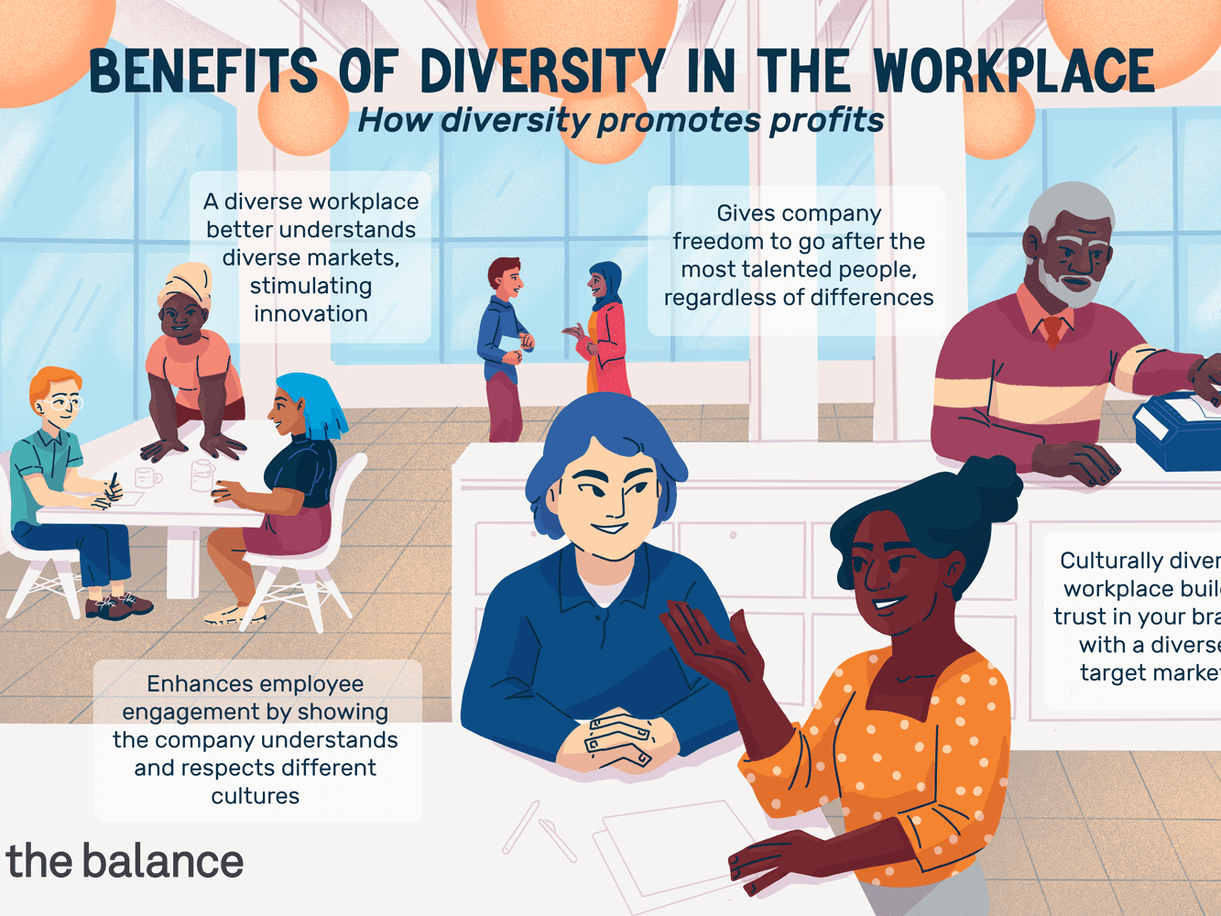
Results Continuation
To attain the result need in for personal development and improvement of human factors, the resources required include;
Willingness to learn more
Conducive environment that allows learning and interacting with diverse groups.
In a workplace, the mentioned aspects can be improved by having an organizational culture that accepts diversity and inclusion, and availability of finances to support creative and innovative ideas.
Notes:
To attain the aspiration, resources need to be put in place to actualize the goals. To improve my cognitive style, knowledge, and personality, I need to be in a better environment that helps interact with diverse groups. Also, the readiness to learn will determine how well I achieve all the expected results. In an organizational setting, change of culture to include diversity is necessary and availing financial resources for innovations and creativity.
Image source: Amadeo (2020).

Slide 8
References
Amadeo K. (2020,June). Cultural Diversity in the Workplace. The balance. Retrieved From https://www.thebalance.com/cultural-diversity-3306201
Chow, I. H. S. (2018). Cognitive diversity and creativity in teams: the mediating roles of team learning and inclusion. Chinese Management Studies.
Cole, M. L., Cox, J. D., & Stavros, J. M. (2019). Building collaboration in teams through emotional intelligence: Mediation by SOAR (strengths, opportunities, aspirations, and results). Journal of Management and Organization, 25(2), 263-283.
White, A. A., Logghe, H. J., Goodenough, D. A., Barnes, L. L., Hallward, A., Allen, I. M., ... & Llerena-Quinn, R. (2018). Self-awareness and cultural identity as an effort to reduce bias in medicine. Journal of Racial and Ethnic Health Disparities, 5(1), 34-49.
Zarestky, J., & Cole, C. S. (2017). Strengths, opportunities, aspirations, and results: An emerging approach to organization development. New Horizons in Adult Education and Human Resource Development, 29(1), 5-19.
Kimbrel D., (2019, May).Stop the Hustle!!! 4 ways to explain the “Inclusion” in Diversity and Inclusion. Retrieved From https://www.linkedin.com/pulse/stop-hustle-4-ways-explain-inclusion-diversity-kimbrel
https://www.slideshare.net/slidemodel/slidemodel-soar-model-powerpoint-template
https://smackslide.com/slide/slide-1-x4qywf

